Slide 1

Chapter 8
How to use Responsive Web Design
Notes:
Session: Ghi số thứ tự session trong môn học
Session Name: ghi tên của session sẽ dạy

Slide 2
Objectives
Introduction to Responsive Web Design
How to implement a fluid design
How to use CSS3 media queries
Build responsive menus with the SlickNav plugin
A web page that uses Responsive Web Design

Slide 3
Introduction to Responsive Web Design
Notes:
Mô tả nội dung chi tiết từng chuyên đề

Slide 4
Responsive Web Design
Responsive Web Design refers to websites that are designed to adapt gracefully to the screen size.
The three components of a responsive design
Fluid layout
Scalable Images
Media queries
Responsive Menu

Slide 5
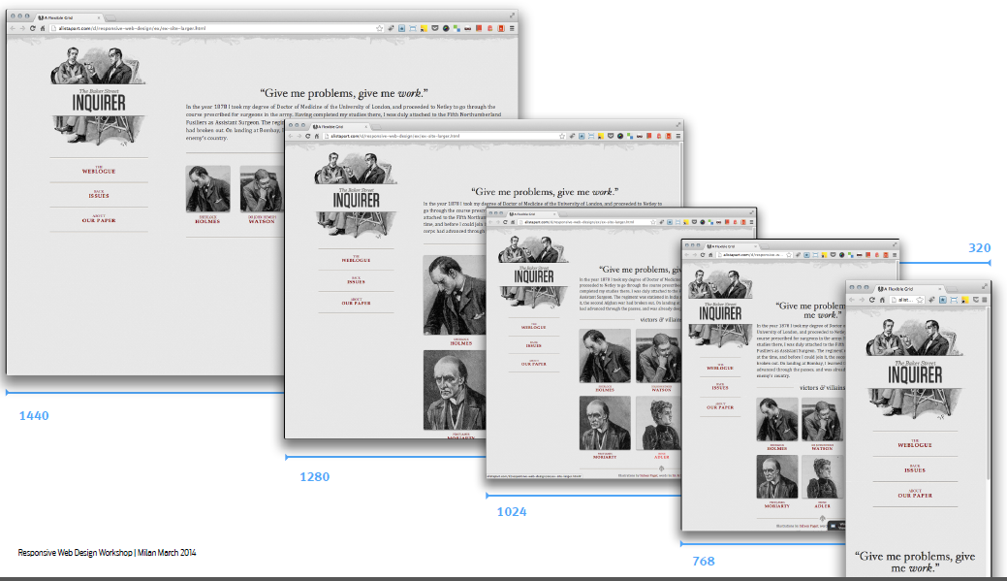
Responsive Design

Slide 6
How to implement a fluid design
Notes:
Mô tả nội dung chi tiết từng chuyên đề

Slide 7
Fluid layouts and fixed layouts
A fixed layout use absolute measurements to specify the widths of page.
A fluid layout use percentages to specify the width of page.

Slide 8
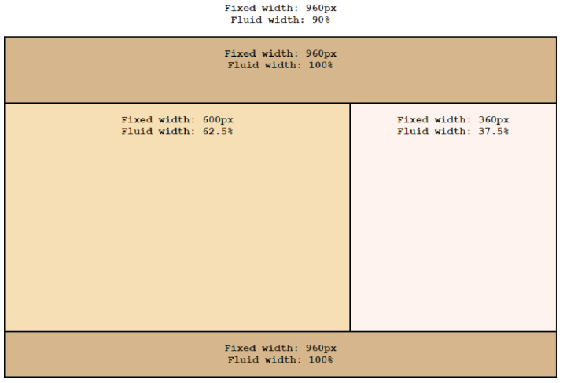
Fluid layouts and fixed layouts(2)

Slide 9
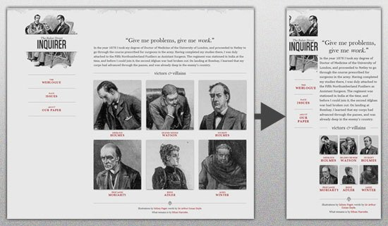
Fluid grids & layouts

Slide 10
CSS for fluid layout
body {
width: 90%; /* changed from 960px */
max-width: 1024px;
margin: 0 auto;
border: 2px solid black;
}
header {
width: 96.875%; /* 930 / 960 */
padding: 15px 1.5625%; /* 15 / 960 */
border-bottom: 2px solid black;
}
main {
width: 59.375%; /* 570 / 960 */
padding: 15px 1.5625%; /* 15 / 960 */
float: left;
}
aside {
width: 34.375%; /* 330 / 960 */
padding: 15px 1.5625%; /* 15 / 960 */
float: right;
}
footer {
clear: both;
width: 96.875%; /* 930 / 960 */
padding: 15px 1.5625%; /* 15 / 960 */
border-top: 2px solid black;
}

Slide 11
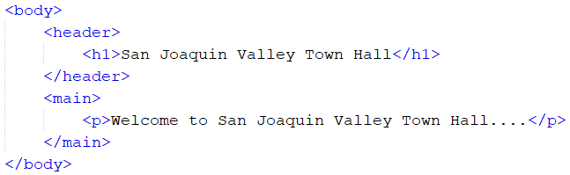

How to use other units of measure with responsive design
Symbol | Nam | Description
vh | Viewport height | One vh is equal 1/100 of the height of the view port.
vw | Viewport width | One vw is equal 1/100 of the width of the view port.
vmin | Viewport minimum | One vmin is equal 1/100 of the height or width of the viewport, depending on which is smaller.
vmax | Viewport maximum | One vmax is equal 1/100 of the height or width of the viewport, depending on which is larger.

Slide 12
How to size fonts
When you specify the size of a font for fluid layout, you should use ems or percent.
CSS for fluid fonts
body {
font-size: 100%; /* 16 pixels */
width: 90%;
max-width: 1024px;
margin: 0 auto;
border: 2px solid black;
}
h1 { font-size: 1.75em; } /* 28 / 16 */
h2 { font-size: 1.5em; } /* 24 / 16 */
h3 { font-size: 1.125em; } /* 18 / 16 */
footer p { font-size: .75em; } /* 12 / 16 */

Slide 13
How to scale images
To create a scalable image, you remove any height and width attribute from the HTML image and set the max-width property of the image in CSS.
CSS for scale images:
section img {
max-width: 100%;
margin-bottom: 9.5em;
}

Slide 14
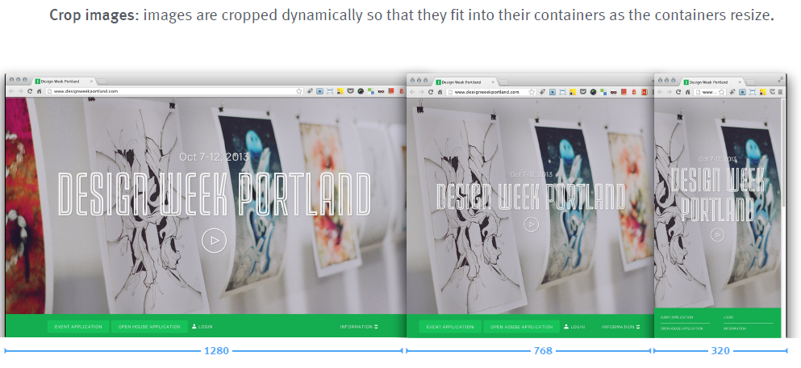
Flexible images and media

Slide 15
How to use CSS3 media queries
Notes:
Mô tả nội dung chi tiết từng chuyên đề

Slide 16
How to control the mobile viewport
The viewport on a mobile device determines the content that’s displayed on the screen.
You can use a meta element to control the viewport settings for a device.

Slide 17
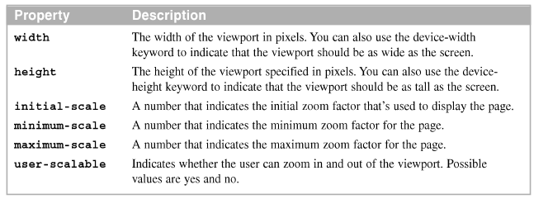
Viewport properties
Content properties for viewport metadata
Meta element that set viewport properties

Slide 18
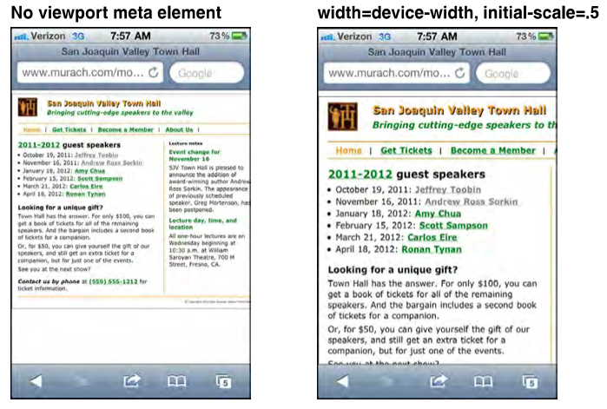
A web page on an iPhone before and after scaling with viewport

Slide 19
How to code media queries
A media queries is define by a CSS3 @media selector.
This selector specifies the media type for query and for screen media type.
If all of the conditions are true, the styles within the media query are applied to the page.

Slide 20
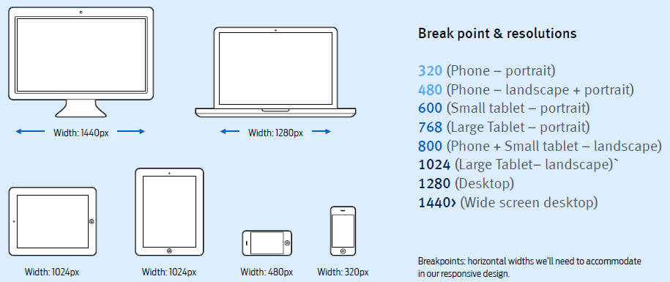
Breakpoints & Media queries

Slide 21
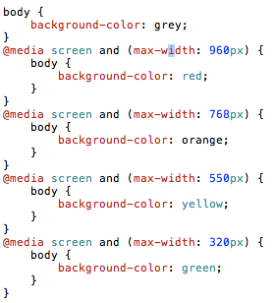
Breakpoints & Media queries

Slide 22
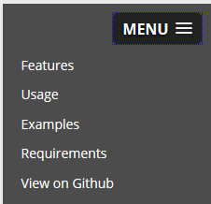
Build responsive menus with the SlickNav plugin
Down load SlickNav plugin from http://slicknav.com
You must include slicknav.css and jquery.slicknav.min.js file

Slide 23
Build responsive menus with the SlickNav plugin (2)
Code for SlickNav plugin
<link rel="stylesheet" href="styles/normalize.css">
<link rel="stylesheet" href="styles/navigation.css">
<link rel="stylesheet" href="styles/slicknav.css">
<script src="https://code.jquery.com/jquery-
2.1.3.min.js"></script>
<script src="js/jquery.slicknav.min.js"></script>
<script type="text/javascript">
$(document).ready(function(){
$('#nav_menu').slicknav({prependTo:"#mobilemenu"});
});
</script>

Slide 24
Build responsive menus with the SlickNav plugin (3)
HTML
<ul id="menu">
<li><a class="scroll" href="#features">Features</a></li>
<li><a class="scroll" href="#usage">Usage
Instructions</a></li>
<li><a class="scroll" href="#examples">Examples</a></li>
<li><a href="http://github.com">View on Github</a></li>
</ul>
JavaScript
$('#menu').slicknav({
prependTo:'#demo1'
});

Slide 25
A web page that uses Responsive Web Design (Page 306)
Notes:
Mô tả nội dung chi tiết từng chuyên đề

Slide 26
Summary
Responsive Web Design refers to websites that are designed to adapt gracefully to the screen size.
A fixed layout use absolute measurements to specify the widths of page. A fluid layout use percentages to specify the width of page.
When you specify the size of a font for fluid layout, you should use ems or percent.
To create a scalable image, you remove any height and width attribute from the HTML image and set the max-width property of the image in CSS.
The viewport on a mobile device determines the content that’s displayed on the screen.

Slide 27
Summary
A media queries is define by a CSS3 @media selector. This selector specifies the media type for query and for screen media type.
You can use SlickNav plugin to build a responsive design menu.

Slide 28
Discussion
Notes:
Trả lời câu hỏi WHY?

